Slide 1
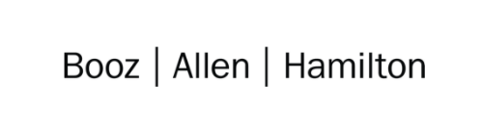

Cloud Excellence Presentation
Team Number 1
Team Name: 1band1sound1inamillion Members: N. Lee-Tanedo, K. Luukkonen, T. Wynh, T. Chafin, K. Craig, P. Iloduba
October 2021

Slide 2
TEAM: 1Band1Sound1InAMillion Project: 127.0.0.1
Our Official Project for the Booze Allen Cloud Excellence Program
www.webagesolutions.com|1.877.517.6540

Slide 3
INTRODUCTIONS
Nico Lee-Tandeo AWS Admin
Kyle Luukkonen Project Safety
Tereek Wynh Scribe/Speaker
Karin Craig Project Safety
Patrick Iloduba Project Safety
Timothy Chafin Project Safety

Slide 4
Project
Introductions
Project Overview
Architecture/Design diagram
Tools/Software Environment used
Demo
Challenges/Issues/Problems/Your stories
What else can we do on the project? - future plan- any design and implementation ideas?
Questions and answers
We wanted to use AWS to allow users to attach object-detection labels to uploaded images on a publicly available web server. The labels would be applied via AWS' machine learning service, Rekognition.
www.webagesolutions.com|1.877.517.6540

Slide 5
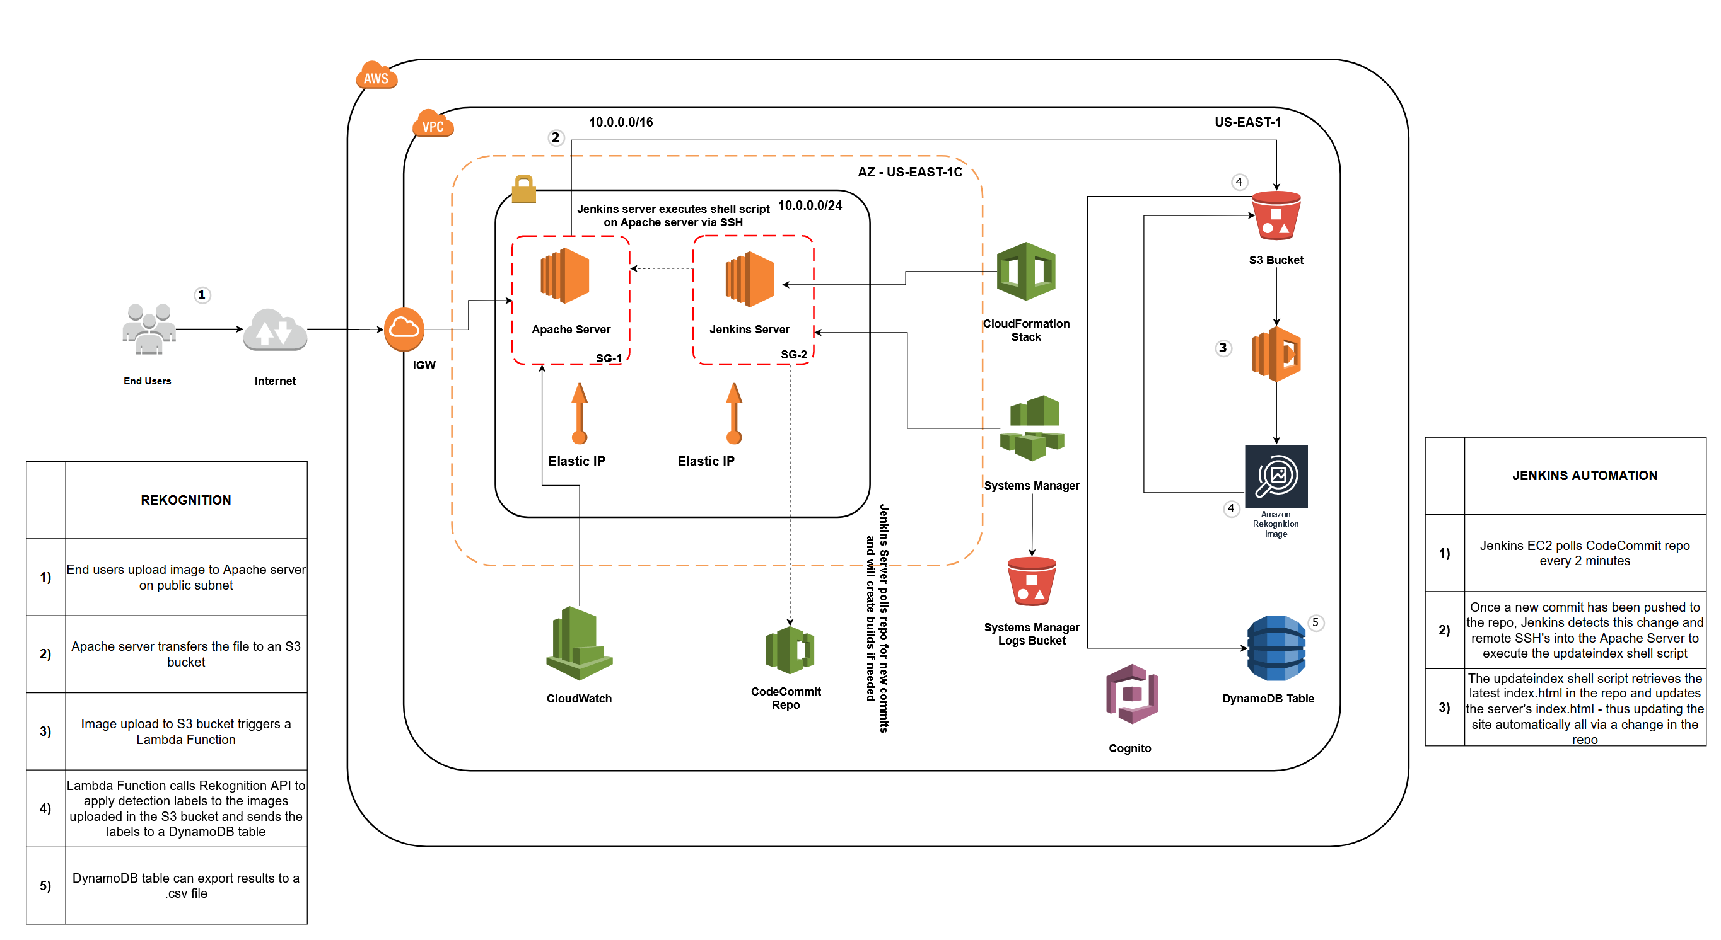
Architecture and Design

Slide 6
Technologies and Environment used
AWS
AWS EC2
AWS S3
CodeCommit
Rekognition - object detection
Lambda
DynamoDB
CloudWatch
CloudFormation
IAM
Cognito – used to create identity pool for unauthorized user access to S3
VPC
Other
Apache
Jenkins
PuTTY & PuTTYgen – used to SSH & convert key pairs
Microsoft VS. Code – code editor
jq (JSON query processor) - installed on Apache. used to query JSON data
Bash script

Slide 7
Demo

Slide 8
Demo

Slide 9
Demo

Slide 10
Challenges and Issues
Stories:
Implementing and abandoning Git Flow
Initial design concept included Sagemaker, but we went with Rekognition
Initial design concept included Googlify, but went with Pre-built Rekognition function (Detect Labels)
The Jenkins journey (Code Deploy issues, Elastic IPs, etc.)
Issues/Challenges:
Integrating AWS to all other services.
Implementing complex code into the Apache webserver, scaling back ambition.
Setting up Jenkins EC2 to execute a shell script on Apache server via SSH.
Replicating all of the minor configurations in CloudFormation for S3
Lessons learned:
For SSH credentials, Jenkins needs all the text of the private key given in .pem format.
For security group rules, the Apache server needed an inbound rule of SSH accepted from the Jenkins EC2’s PRIVATE IP (been using public IP and had connection issues).
Modifying code in EC2 instance connect is not ideal.

Slide 11
Future State - What we would add
Better security (login for users, locking down inbound rules)
Display the Rekognition output to the user on the web server
Jenkins automating CloudFormation deployments
Systems Manager

Slide 12
Thank you!!!
October 2021

Slide 13
Q & A - Ask us anything

